Slide 1

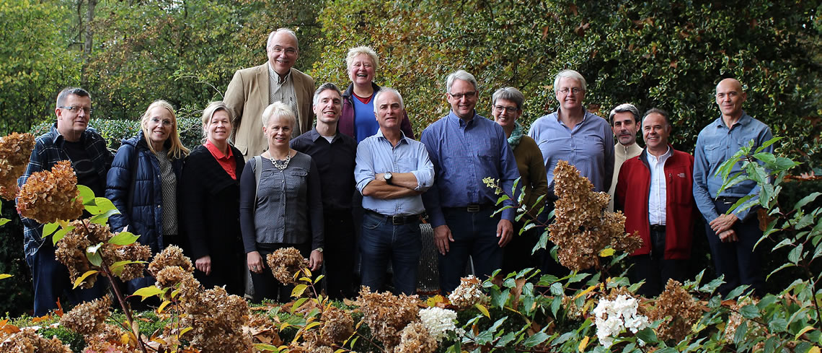

Slide 2
What’s On The Programme
EQF
Learning outcomes
New Skills Agenda for Europe
LOASA background
Project outcomes
Notes:
I want to start with issues on a European level so you get an idea of the context, and then zoom in and focus on the LOASA project.

Slide 3
Putting The Work Back In Workshop
What elements do you like so much that you consider using them yourself?
How could we improve this project and its outcomes? All suggestions are welcome.
27 April, 2018
3
Notes:
But first… we have some tasks for you at the end of this session.
Please prepare yourself for these questions.

Slide 4

A True Love Story
Notes:
Jana: Trained as a state-certified pharmaceutical-technical assistant at the Berufsfachschule, with the option to get a Fachhochschulreife qualification (university of applied sciences qualification), provided she had a grade of 3 (and took extra lessons and did an exam). Although she worked as a pharmacy assistant in Germany, and does speak Dutch fluently with a charming accent, she could not find a proper job in the Netherlands.
Jeroen graduated with a diploma from a college in Amsterdam on EQF level 4 as cabinet maker (also called a joiner). But in Germany has a master-apprentice system with the master craftsman (Meister) being the highest professional qualification in crafts. This is a state-approved grade that transcends the lower ranks of apprentice and journeyman. Due to his Dutch VET diploma, Jeroen was not recognized by the German labour market as Meistertischler, as master cabinet maker.
Their story is exemplary for what’s happening everyday in Europe.
Other real life examples: Saskia from NL in Norway, Karolina from Poland in Denmark, Judith from Serbia(?) in Hungary, I could go on and on

Slide 5
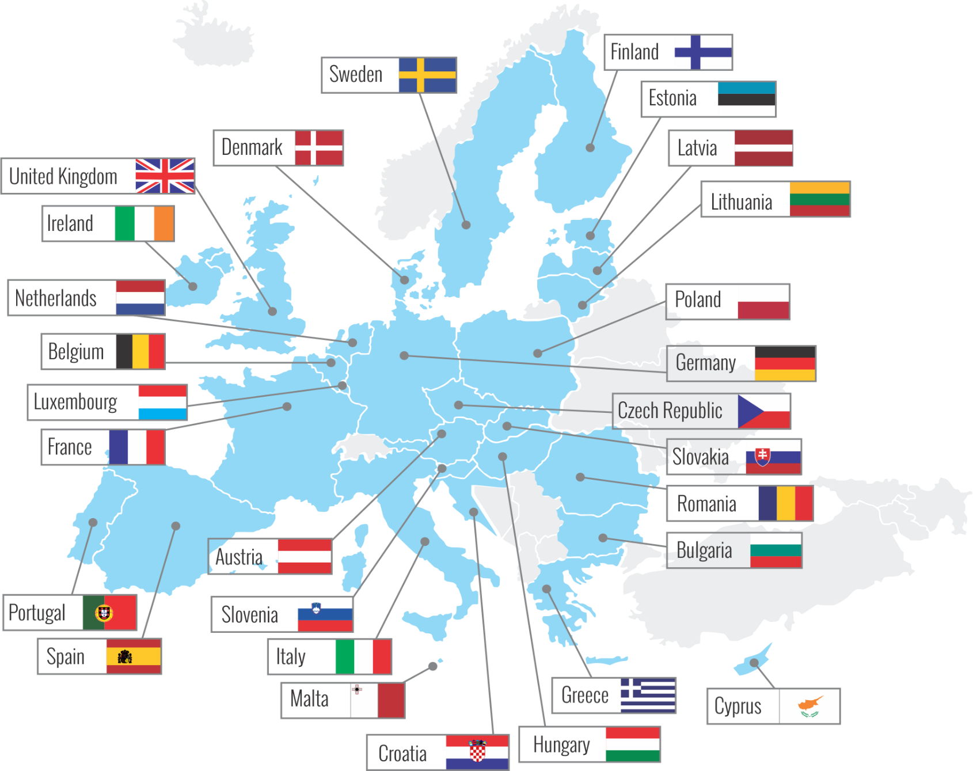
Issue
Notes:
Problem: We may have 1 European Union but we have roughly 30 different education systems in Europe.
That makes it very hard to compare qualifications and diplomas. As a result, it’s challenging for people to work and live in another country. And for Europea as a whole, it’s challenging to make supply and demand on the labour market meet.

Slide 6
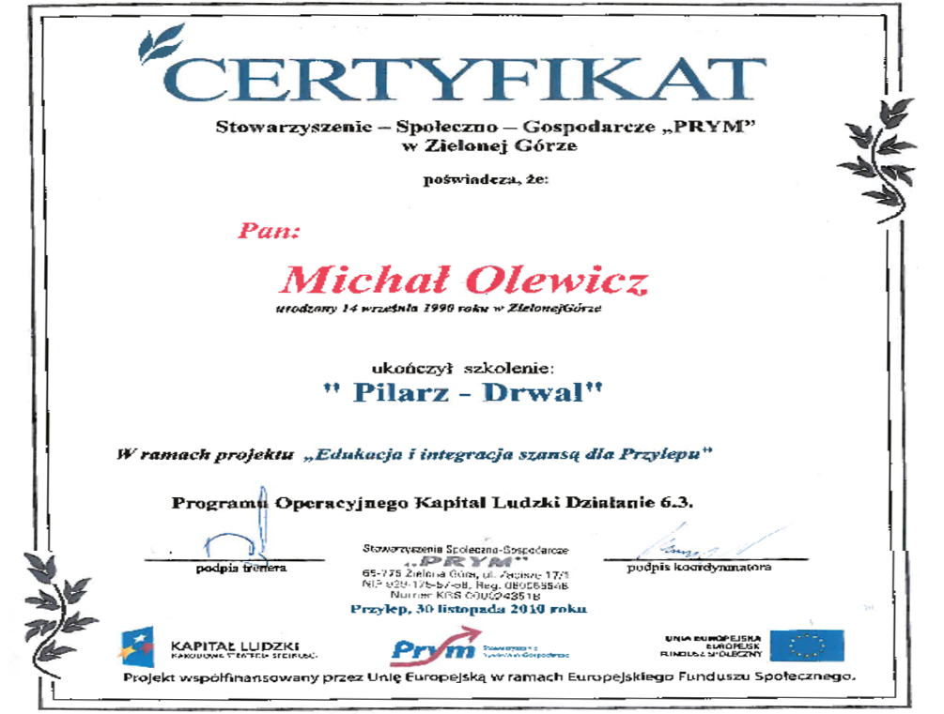
Notes:
Please tell me: what’s the value of this certificate?

Slide 7
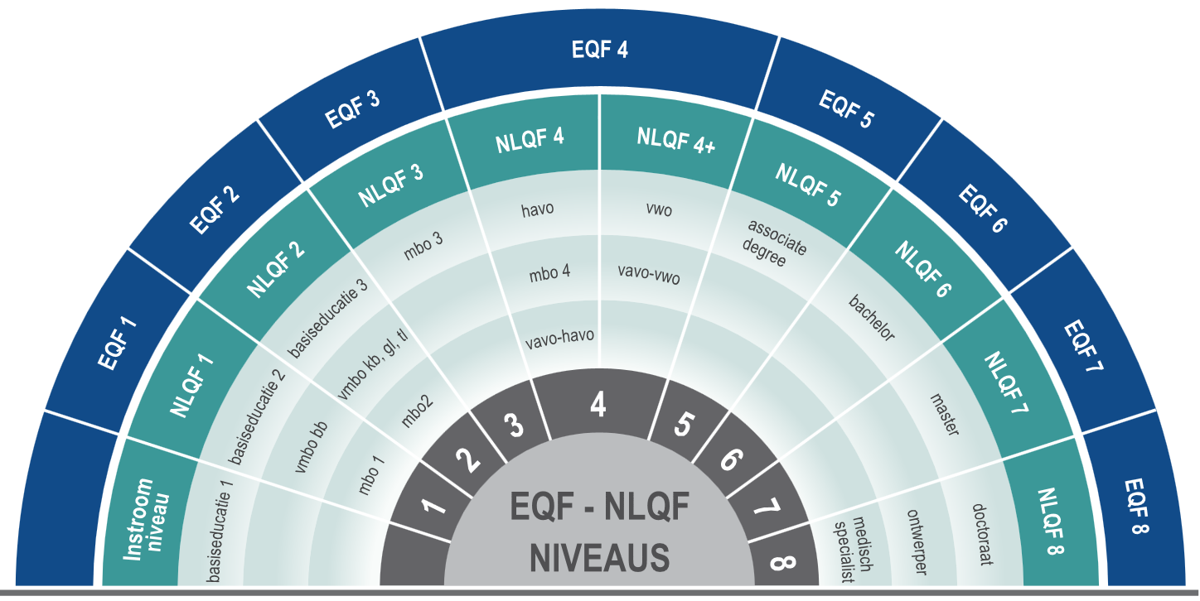
Solution: EQF
Notes:
EQF = the ‘euro’ for education. It’s a sort of Google Translate tool for qualifications.
Thanks to the EWF, we now know that e.g. level 6 of the Scottish national framework equals level 4 of the EQF. And that level V of the French national qualification
framework equals level 3 of the EQF. And thanks to the EQF you can interpret the value of level 4+ of the NLQF in the Netherlands.
Please be aware that EQF bears qualifications in the name but is about levels of work.

Slide 8
What defines the EQF levels?
  Complexity
  Responsibility
  That’s it? That’s it.
Notes:
EQF levels are NOT defined by learning inputs such as:
Length of the training course (study hours, number of pages of a book)
The educational method or approach
The training material (books or iPads or YouTube or learning by doing and using your hands)
Way of assessing
Learning pathways
Where the learning is taking place (whether it’s formal learning, or informal or non-formal learning)
Age of the learners
Etcetera

Slide 9
Hence Learning O utcomes
Learning outcomes are what someone knows and is able to do after the completion of the learning process…
…no matter where learning has taken place.
Described in line with the EQF (make sure that vocabulary matches with the EQF levels)
Notes:
Start with the end in mind. We are not only speaking in terms of learning outcomes in education and training contexts. It is also about non-formal and informal learning situations. When putting this into a training context, the input is not longer the starting point (study hours, number of pages of a book, other training material), but that the output (‘where do we have to end’) is the starting point. Obviously this has impact on the way we have to teach and assess. Traditional learning situations might not be sufficient to achieve some of the learning outcomes. This also implies a stronger focus on the needs of the learner instead of the intentions of the trainer or teacher.

Slide 10




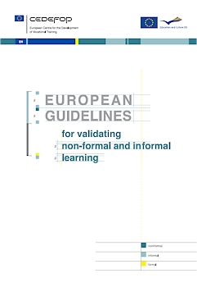
Transparency of VET qualifications
LO approach
Quality of VET systems
Mutual trust
Progressive access to VET qualifications
Transfer and recognition
Promoting LLL
Transfer and recognition from NFIL to formal system
Skills and qualifications clearly and easily understood in Europe
Notes:
EQF and ECVET are part of a integrated set of instruments recommended by the EU. In my experience it’s best to use *all* of the tools from this toolkit, and not just pick 1 or 2 and ignore the rest.

Slide 11

New Skills Agenda for Europe
Notes:
Aim: to strengthen human capital, employability and competitiveness.
67 million jobs in Europe are below level 3
17 million jobs are in danger!

Slide 12
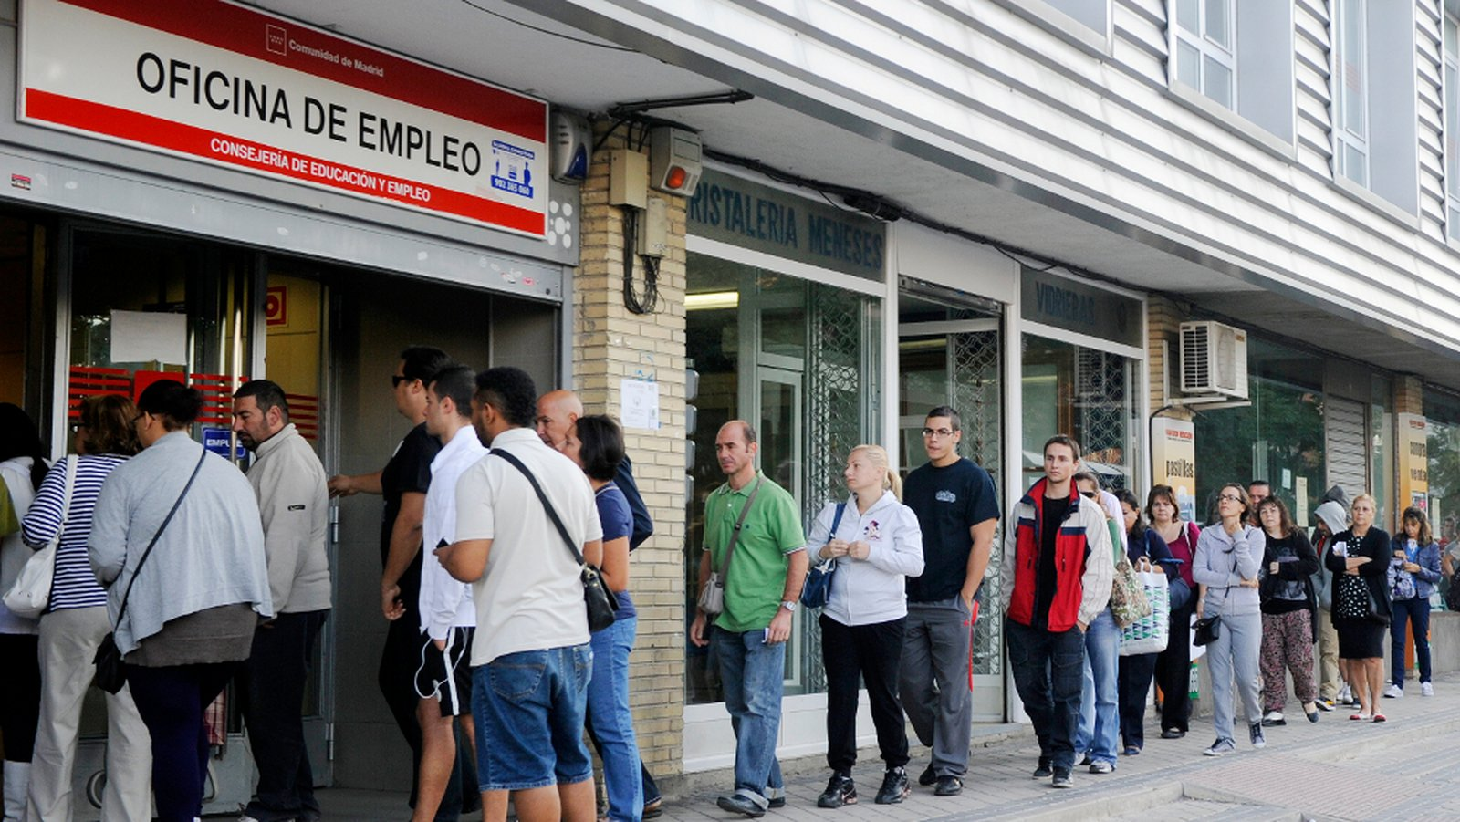
Necessity and Urgency
Notes:
Does Europe needs a New Skills Agenda? Yes, because
Youth unemployment is still very high in the EU (over 40% in some countries)
In Europe >4.2 million people of <24 years are without a job. (as of August 2016). Long-term youth unemployment rates are still the highest in decades.
67 million jobs in Europe are on EQF level 3, 2 and 1. 17 million jobs are at risk. These jobs will dramatically change, or even disappear.
At the same time, 40% of the employers in Europe can’t find workers with the right skills.

Slide 13
Priorities Of The Skills Agenda
  To improve the quality and relevance of skills formation;
  To make skills more visible and comparable;
  To improve skills intelligence and information for better career choices.
Notes:
With the LOASA project, we focus most on priorities 1 and 2

Slide 14









Skills According to the Skills Agenda
Generic
cognitive
skills
Technical, professional,
sector-specific
skills
Socio-emotional skills
Notes:
The New Skills Agenda for Europe, launched in 2016, has adopted the language of the labour market. Rather than speaking about knowledge, skills and competences, it speaks about different kind of skills. Just as employers simply say the need skilled workers, and don’t differentiate between knowledge, skills and competences.
The importance of the social-emotional skills (which more or less includes the 21st century skills) has increased. We, educational institutions, need to adjust to it.

Slide 15
Why?
Within the EU, a decrease in employability is foreseen because employers do not find workers with the skills that are demanded.
This skills gap is most likely to increase in the green sector (agriculture, livestock and environment) and in the lower qualification levels (EQF levels 1, 2 and 3).
Notes:
According to research by world economic forum, cedefop, etc => see loasa website at http://www.loasa.eu for sources

Slide 16
Objective Of LOASA Project
Bridging the gap between the skills acquired in formal and non-formal education and the actual demands from the labour market.
better employability
Notes:
Overall goal. Quite ambitious ☺

Slide 17
LOASA facts
The project is funded by a grant from Erasmus+. Main applicant is Wellantcollege, which also acts as project coordinator.
The project is a partnership between VET professionals and business partners from the green sector of four European countries (Denmark, Finland, Netherlands and Spain).
Duration of the project is 24 months from September 2016 to August 2018

Slide 18

Meet The LOASA Partners
Industry representative
Linnainmaa/Kaupin dairy farm
ProAgria, Österbottens Svenska Lantbrukssällskap
Education representatives
Sastamalank oulutuskuntayhtymä (SASKY)
YA - Vocational College of Ostrobothnia
Notes:
Who are contributing to the LOASA objective?

Slide 19

Meet The LOASA Partners
Industry representative
AB Kirketoft
Education representatives
Green Academy Aarhus

Slide 20


Meet The LOASA Partners
Industry representative
Centro Tecnológico Nacional de la Conserva y la Alimentación (CTC)
Education representatives
Centro Integrado de Formación y Experimentación Agraria (CIFEA) de Lorca
Centro Integrado de Formación y Experimentación Agraria (CIFEA) de Molina de Segura

Slide 21
Meet The LOASA Partners
Industry representative
Van Senten Groenprojecten
Education representatives
Wellantcollege

Slide 22
How does LOASA contribute?
By developing units of learning outcomes
based on a framework that incorporates:
EQF
ECVET principles
The New Skills Agenda
Recognition of formal, non-formal and informal learning
Collaboration with partners from the world of work

Slide 23
LOASA target groups
VET students and unemployed people on lower and middle EQF levels (1-3).
Schools who aim to foster excelling VET students on lower and middle EQF levels.
Employers who need improved transparency of acquired skills for a better human resources policy in their companies.

Slide 24
LOASA’s long-term benefits
Bridging the skills gap by recognizing learning outcomes through formal and non-formal learning.
Increasing the employability of VET students and employees on lower and middle EQF levels.
Exchange knowledge between VET and the world of work.
Units of learning outcomes and assessments as a tool for HRM at companies.

Slide 25
After the project has finished
All participating countries will have piloted units of learning outcomes that
  were developed in cooperation with the world of work
  align with the New Skills Agenda for Europe.
Based on the pilots, LOASA will present recommendations for further development.

Slide 26
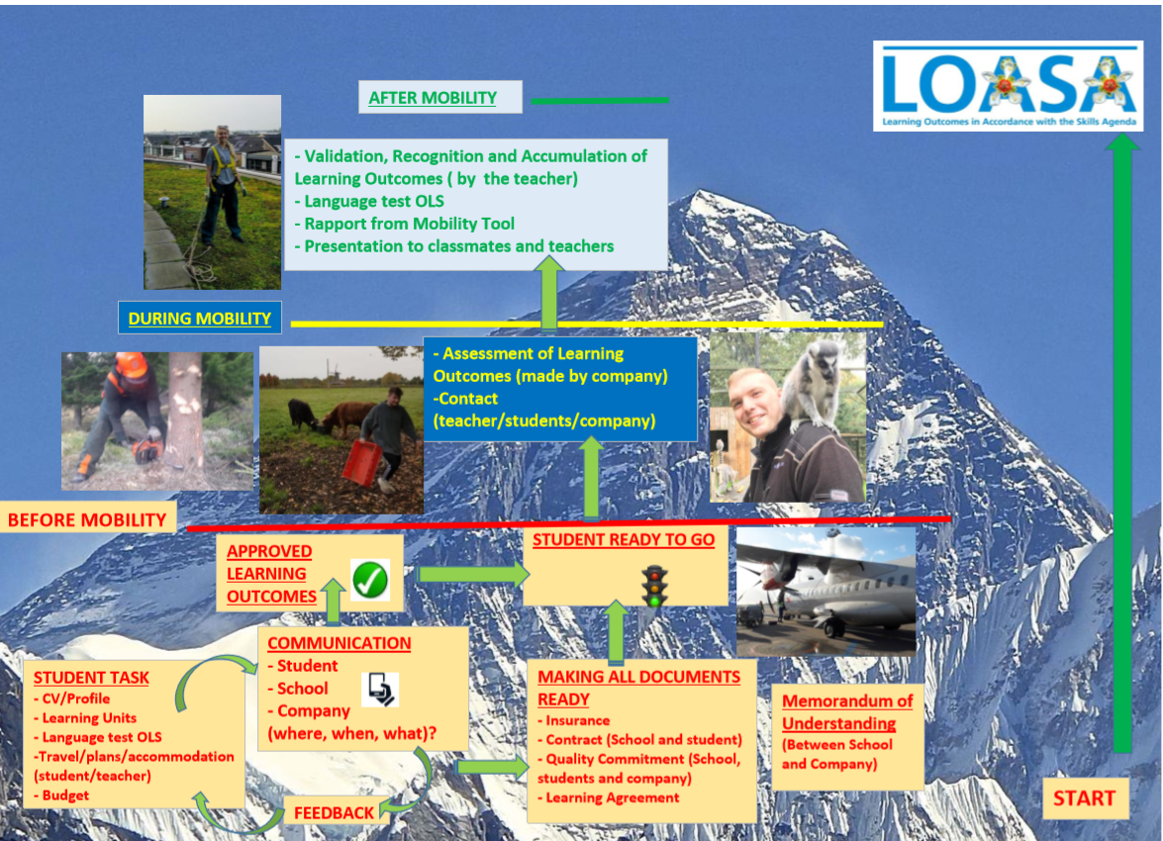
LOASA Project Outcomes
Notes:
Output 1: a common framework that covers all parts of the process. See loasa.eu for the framework plus additional explanation

Slide 27
Notes:
Example of a learning unit

Slide 28
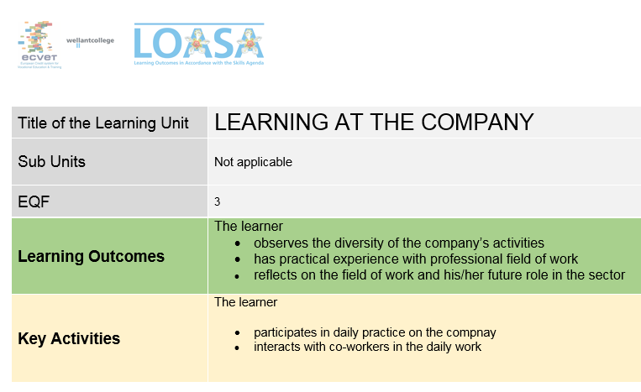
Notes:
We even made a learning unit for learning AT the company rather than learning IN the company, which can be used for short-term internships / work p[lacements.

Slide 29
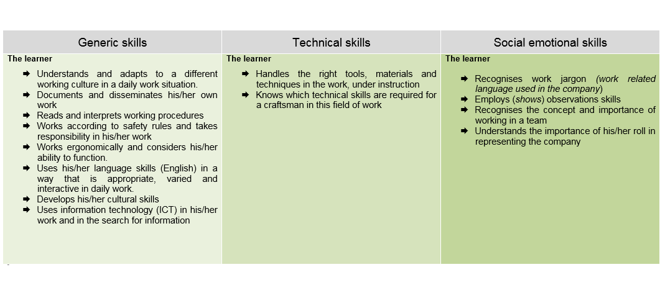
Notes:
Part 2 of the learning unit….

Slide 30
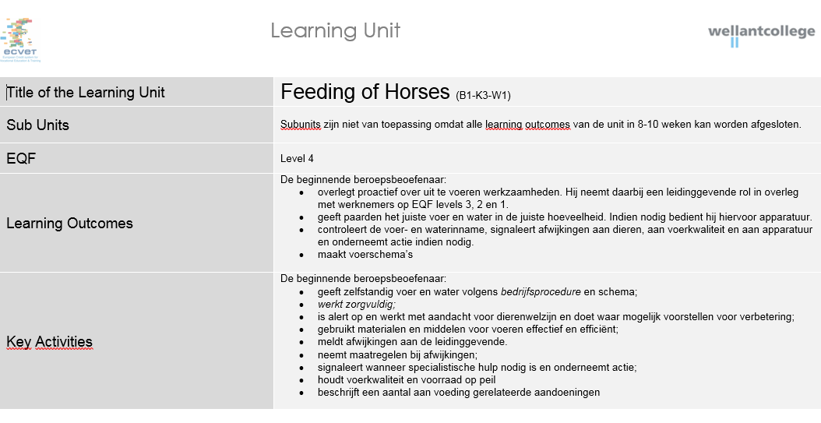
Notes:
Another example of a learning unit. This one is in Dutch, and is an example of the project’s impact: at Wellantcollege,the course Equine Sports and Management makes a transition to a fully-learning outcome-based approach.

Slide 31
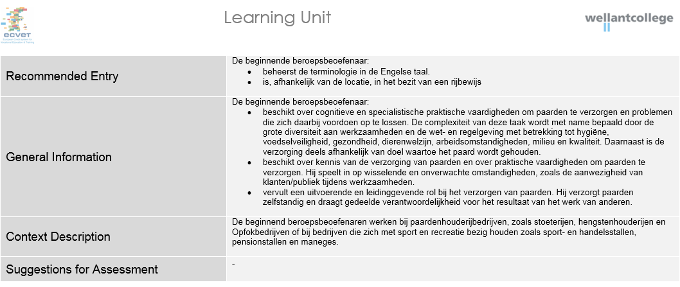
Notes:
Second part of the same learning unit. This is not part of the EU reccomendations / it’s not obligatory but we have experienced that these fields help clarify the unit to all stakeholders. To put it in other words: it helps to get on the same page.

Slide 32
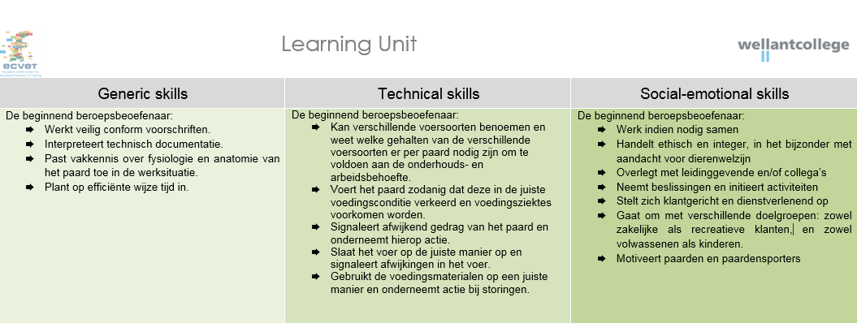
Notes:
Part 3 ofthe learning unit.

Slide 33
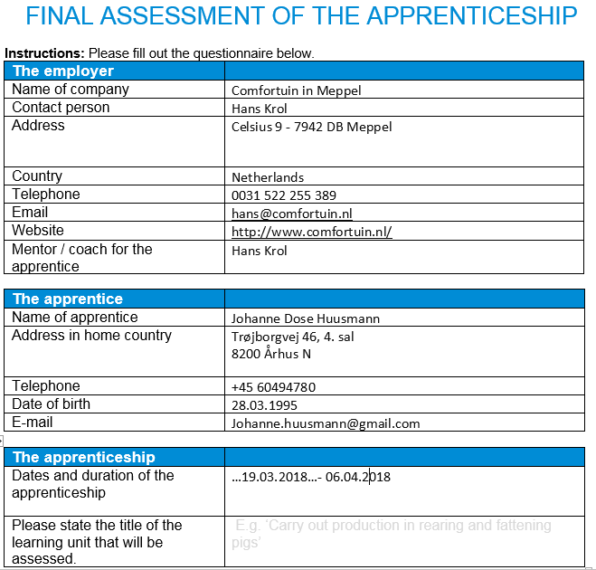
LOASA Project Outcomes
Notes:
Another intellectual output of the LOASA project is an assessment form for the learning outcomes. This form is based on the Danish format but is used by all LOASA partners.

Slide 34
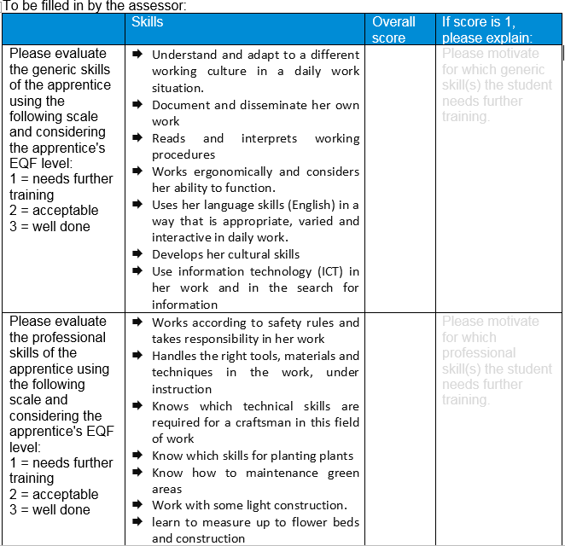
LOASA Project Outcomes
Notes:
Part 2 of the LOASA assessment form

Slide 35
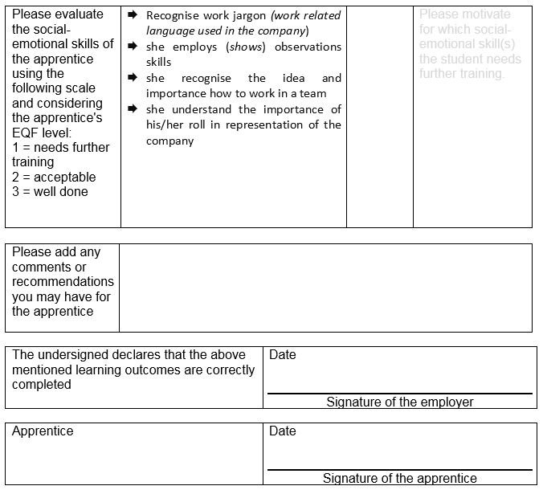
LOASA Project Outcomes
Notes:
Final part of the LOASA assessment form. It is available for free at loasa.eu

Slide 36
LOASA Project Outcomes
Pilot
Impact so far
Lessons learned

Slide 37
Putting The Work Back In Workshop
What elements do you like so much that you consider using them yourself?
How could we improve this project and its outcomes? All suggestions are welcome.
27 April, 2018
3
Notes:
Back to the tasks provided at the start of this presentation. Please provide your feedback.

Slide 38
Merci beaucoup
LOASA
website: http://loasa.eu
mail: info@loasa.eu
27 April, 2018
3
Notes:
Feel free to get in touch. We’re happy to share.

